Slide 1
Music Library Database
In this database we create a Music Library Database in which we create a database of Music Library , where we create a table and add some columns like music id, music name, singer name, release date and after that we insert some data in this table after it add a column using Alter command after that using UPDATE command add data in that column.

Slide 2
Creating Database:
In this slide we create Database and use that Database.

Slide 3
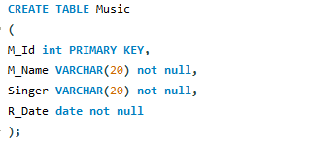
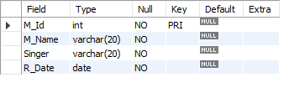
Creating a Table:
In this slide after creating or using Database we create a Table for that Database
Using create table command.

Slide 4
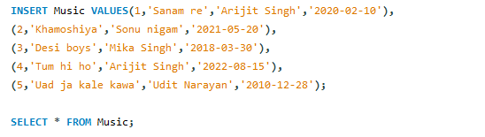
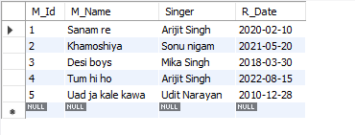
Inserting Data in Table:
In this slide we insert the data in table using Insert command.

Slide 5

Adding new Column:
For adding new column in in table we use Alter command.

Slide 6

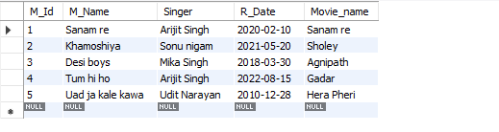
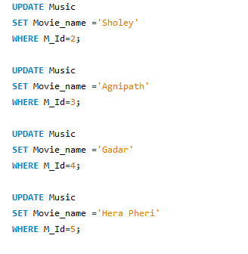
Updating the Table:
In this slide we Update the table using Update
Command.

Slide 7
Created BY:
Tanmay varshney.
Ajay singh.
Devi Dayal.
Sowjanya.
Thank you for watching.

